Slide 1
Online Proctoring: A key feature of secure high stakes tests in the future?
Roger Johnson & Marios Molfetas
Chair of the Advisory Council & Development Director
roger.johnson@languagecert.org
marios.molfetas@languagecert.org

Slide 2
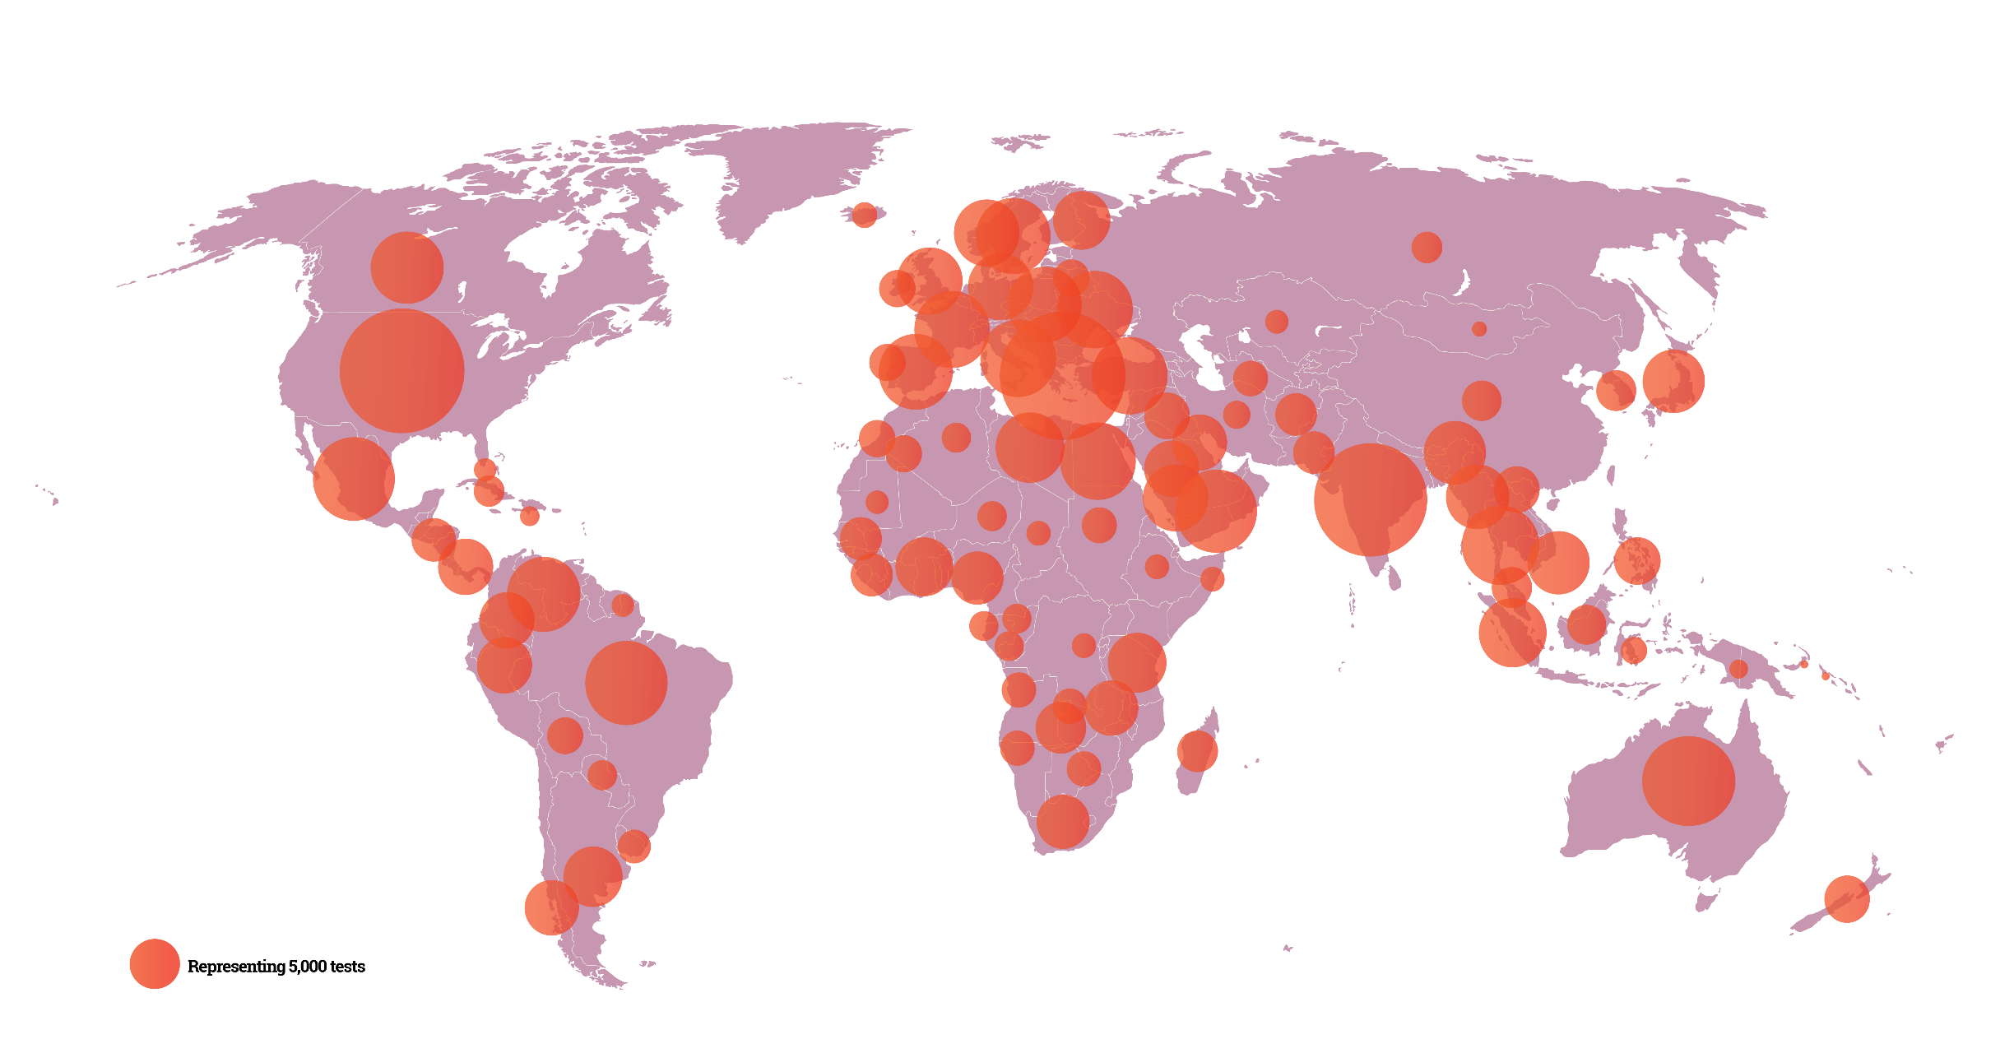
A picture is worth
1000 words.

Slide 3
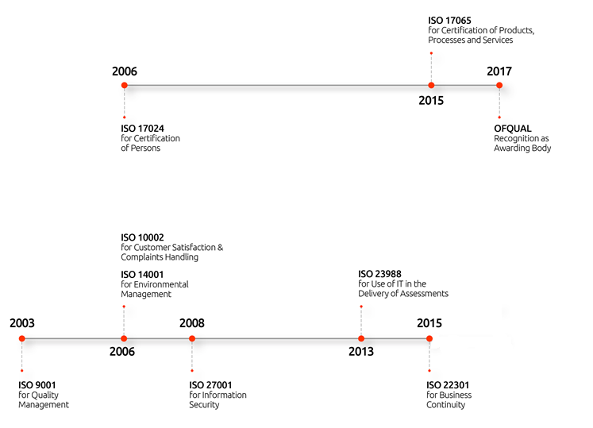
Accreditations
QUALITY
Commitment
to Quality.
Certifications by Lloyd’s Register UK

Slide 4
Comprehensive Portfolio
500+ Qualifications & Growing.
Business and IT Qualifications
AXELOS Best Management Practice (ITIL, PRINCE2, MSP, MoV, MoR, P3O, RESILIA)
COBIT (ISACA), DevOps (Dev Ops Institute),
DMI (Digital Marketing Institute)
Lean IT (Lean IT Association)
Lean Six Sigma (IASSC)
ECDL/ICDL (ECDL Foundation),
Quality Software Developer (PeopleCert and SIG)
Professional Valuers (Appraisers)
Greek Capital Commission, Tourism Professionals
Management Systems Professionals
Other certificates under development

Slide 5
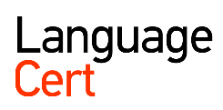
Comprehensive Portfolio
500+ Qualifications & Growing.
Language Qualifications
ENGLISH
LanguageCert International ESOL
LanguageCert Young Learners ESOL
SPANISH
LanguageCert USAL esPro
TURKISH
LanguageCert Ankara University TÖMER
Portfolio to be enriched & more languages on the way

Slide 6
WHO WE ARE
About
LanguageCert.
A PeopleCert Group company
Awarding Organisation dedicated to
language skills assessment & certification
Develops own language qualifications
Partners with renowned organisations worldwide to offer high-quality language skills assessment and certification
Deploys PeopleCert’s state-of-the-art, innovative and flexible exam administration technologies and systems, and benefits from excellent Customer Service 24/7/365
LanguageCert is a business name of
PeopleCert Qualifications Ltd

Slide 7
Online Proctoring: Online Proctoring explained Evaluating Online Proctoring Future developments & research PeopleCert & Online Proctoring

Slide 8
Proctoring explained
Proctoring = Invigilation:
“Watching people taking a test
to make sure they don’t cheat”
Cheating:
Using prior knowledge of test content
Getting test answers by illicit means
Impersonation or substitution
Copying
Recording test content & responses
The cheating triangle: (D’Souza, 2017)
incentive
opportunity
rationalisation
Notes:
Also organisation/logistics
It’s about fairness and effective assessment

Slide 9
Online Proctoring explained
Online (or Remote) Proctoring:
Using a person and/or system to support invigilation
Where the proctor is not physically present
Uses online connectivity to observe/ analyse/ record test taker behaviour
“The internet didn’t invent dishonesty” (Berkey 2015)
Notes:
Can be a combination
In fully automated version – no proctor
Deters/prevents/identifies malpractice

Slide 10
Where does Online Proctoring come from?
It builds on online learning and CB testing:
Some benefits of CB testing
Fast results
Auto marking
Analytical feedback
No print/shipping costs
More secure (fewer people in delivery chain)
Offers flexibility & choice
Much emphasis on design of online learning, much less on e-invigilation (Ketab, 2015)
Notes:
CB 20 yrs/40 yrs?
Now very widespread – add numbers
Inc. high stakes
Which of above most significant? Depends on perspective. But Flex is the big attraction do a test when you want/when you’re ready.
What other services/products provided so you have no control over when supplied…..? Do we like them? Testing = individual experience
Constraints of CB – test centre/kit available/reliable connection

Slide 11
What is Online Proctoring addressing?
CB testing centres have to be in multiple locations with equipment,
premises and staff on site
Online Proctoring removes requirements for
equipment
location
invigilator present
While supporting
security
cost effectiveness
fair & accurate assessment
Notes:
Have to be organised + staffed (are have to be distributed, to be convenient to cands.). Staff to check identity/prevent cheating
Still requires kit and room spec

Slide 12
Types of Online Proctoring
Live online proctoring
and/or
Recorded proctoring
and/or
Fully or semi-automated proctoring
Notes:
Add reference
Simple to sophisticated. Cumulative (some). Refer to fully automated model
1. One step up from Skype
2. Fast fwd x 3 – x20

Slide 13
Is Online Proctoring the future?
The Future of Assessment
CB will grow, & flexibility in assessment delivery is required
Demand to address individual needs (genuine flexibility/availability)
Tests will occur more often at candidate’s home, employment, etc.
Candidates expect to use range of tools
Notes:
Or the present!
Tools (mic, camera, systems – also new skills to test via CB –webpages, etc.)
CB – new skills to be represented

Slide 14
Benefits of Online Proctoring
Research areas:
Does Online Proctoring
impact on fair and effective assessment?
avoid being invasive and unfriendly?
support and improve test security?
represent a cost-effective model?
(Karim, 2014; Ketab, 2015; Weiner, 2017)
Notes:
Or the present!
Tools (mic, camera, systems – also new skills to test via CB –webpages, etc.)
CB – new skills to be represented
Research: language test – are they any different?

Slide 15
Developments in Online Proctoring
Developments & research – further use of multi-modal biometrics
Facial recognition to deter impersonation
Keyboard behavior analysis
Broader use of AI to identify patterns of unusual behavior/response
Notes:
Are these PC plans or general comments?
Use of Fitbits
Any particular considerations re language tests (e.g. keyboard patterns)

Slide 16
PeopleCert’s Online Proctoring
Main features:
Allows candidates to sit secure CB tests in any location
Prevents attempts to cheat and deters impersonation, copying, learned responses
Candidates and their screens monitored online
Monitoring software tracks actions and behaviour
Candidates need access to - a suitable device (laptop, etc.)
- an internet connection (256 + kbps speed)
- a webcam and a mic
- any modern browser

Slide 17
PeopleCert’s Online Proctoring
Candidate Steps
1. Exam ordering
2. Exam preparation
(Compatibility checks, informational videos)
3. Onboarding
(Semi-automated onboarding, Proctor assisted)
4. Exam taking
(Complete lockdown, Candidate monitored)
5. Results
(Report & Auditing)

Slide 18
PeopleCert’s Online Proctoring
Candidate downloads exam application
Locks down browser to mitigate content theft and cheating
Two kinds of prevention features:
- Navigation Prevention Features
- Infringement Prevention Features

Slide 19
Navigation and Infringement Prevention Features
Navigation Prevention Features:
Prevents right-click
Prevents function keys
Prevents some key combos
Hides Taskbar and Desktop
Hides menus and icons
Prevents window minimization
Prevents Copy/Paste
Prevents printing
Infringement Prevention Features:
Terminates blacklisted applications
(e.g. screen capture & keyloggers)
Prevents launch of applications during
the exam session
Terminates communications software
Prevents execution on virtual machines
Prevents simultaneous tests
Allows single monitor only

Slide 20
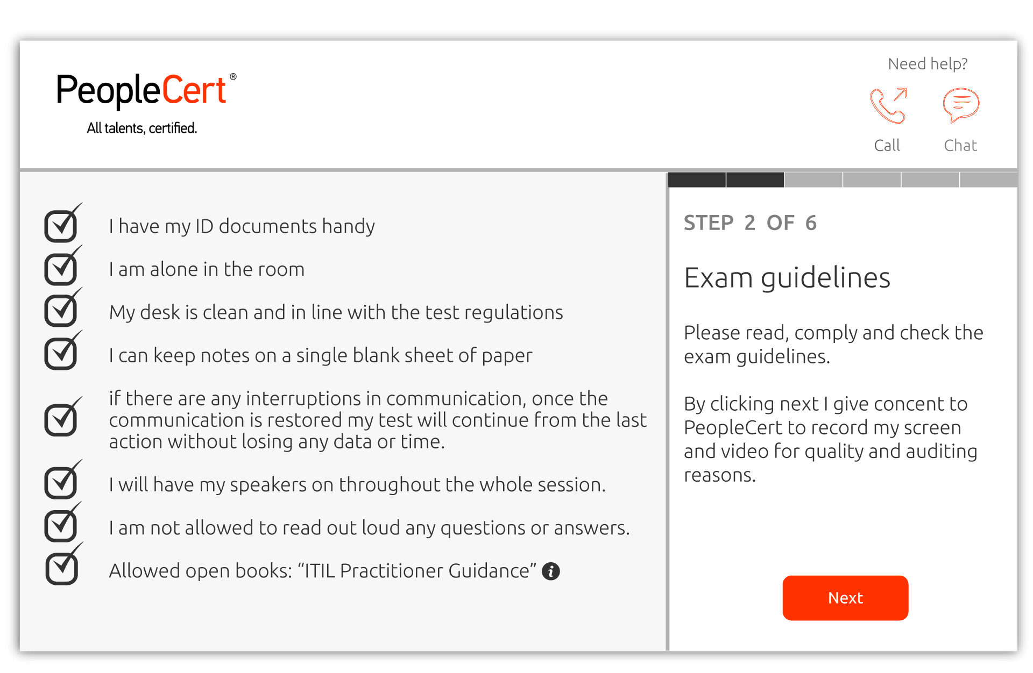
Online Proctoring - Initial Candidate’s checks

Slide 21
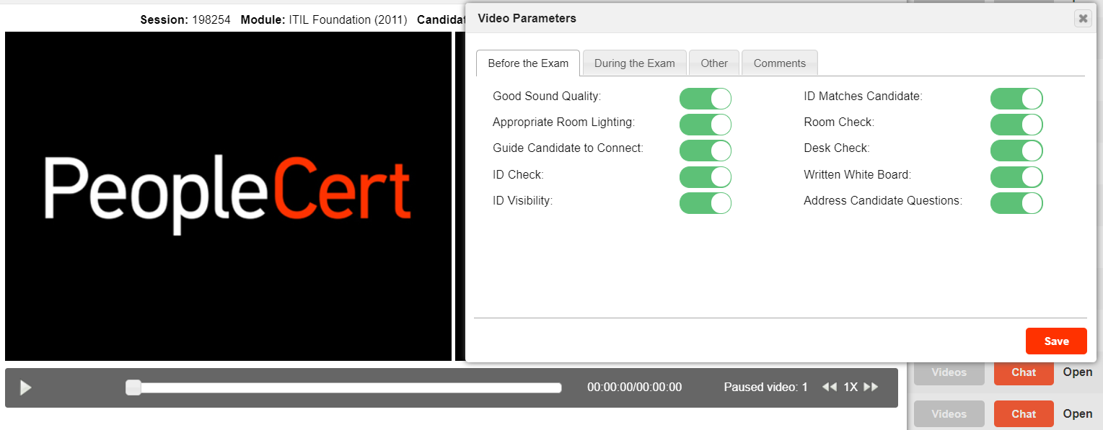
Online Proctoring - Initial Proctor’s checks

Slide 22
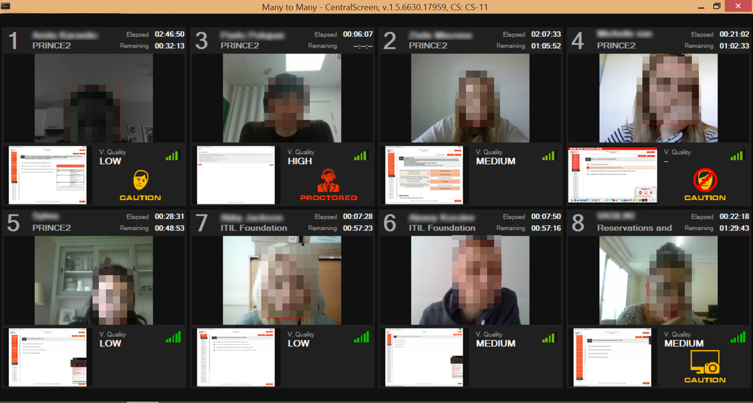
Live Proctoring
Proctor to Candidate ratio 2:8
Ensures that at least one proctor monitors the candidates at all times
Proctors use a 40-inch screen and observe up to 8 candidates at once
All candidate and system actions monitored, logged and timestamped
Notes:
Query ratio vs cost!
Recorded

Slide 23
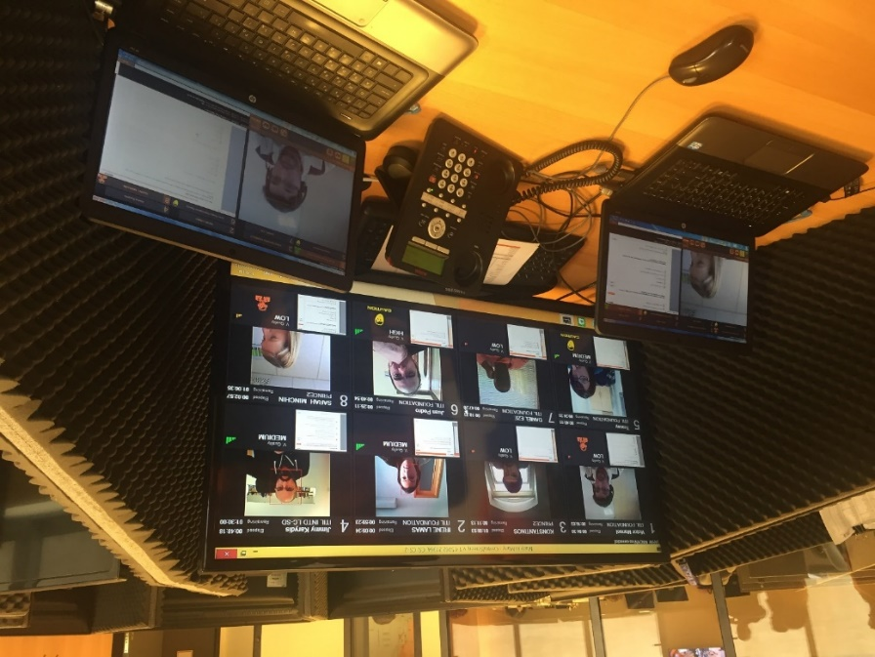
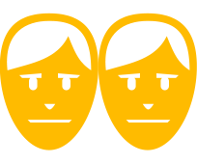
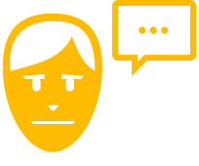
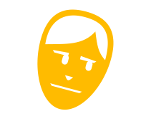
Monitoring Software
PeopleCert uses its own communication
and monitoring software
Proctors can communicate with candidates
and identify notable behavior
Software analyses:
Voice detection / Candidate Talking
Candidate Tilting Head
Missing face
Multiple faces detected
Background noises
Alerts represented with icons on the proctor’s interface
All alerts tagged, timestamped and logged.
Multiple faces
detected
Candidate
talking
Candidate
Tilting head
No face
detected
Background
Noise detected
Low
Battery

Slide 24
PeopleCert’s Auditing
Authorized auditors :
Select and replay any test
Playback recordings at different speeds
View automated tags - captured by the system or added by proctor
Play the video at time stamp
Tag and add comments on video

Slide 25
Online Proctoring – and languages
Conclusions:
An addition to traditional test venues
Supports accessible testing in remote areas, for people who can’t travel, etc.
Enables a more personalised provision in future
Combines technology and a friendly face to provide high quality service
Currently piloting LanguageCert CB exams, including online Speaking

Slide 26
Berkey, Dennis & Halfond, Jay. (2015) Cheating, Student Authentication and Proctoring in Online Programs. New England Journal of Higher Education, http://www.nebhe.org/thejournal/cheating-student-authentication-and-proctoring-in-online-programs/
D'Souza, K. A. and Siegfeldt, D. V. (2017), A Conceptual Framework for Detecting Cheating in Online and Take‐Home Exams. Decision Sciences Journal of Innovative Education, 15: 370-391. doi:10.1111/dsji.12140
Karim, Michael & Kaminsky, Samuel & Behrend, Tara. (2014). Cheating, Reactions, and Performance in Remotely Proctored Testing: An Exploratory Experimental Study. Journal of Business and Psychology, 29. 1-18. 10.1007/s10869-014-9343-z.
Ketab, Salam & Clarke, Nathan & Haskell-Dowland, Paul. (2015). E-Invigilation of E-Assessments. Conference: Proceedings of INTED2015 Conference 2nd-4th March 2015, Madrid, Spain
Weiner, John A. & Hurtz, Gregory M. (2017) A Comparative Study of Online Remote Proctored versus Onsite Proctored High-Stakes Exams. Journal of Applied Testing Technology, v18 n1 p13-20
Notes:
Are these PC plans or general comments?
Use of Fitbits
Any particular considerations re language tests (e.g. keyboard patterns)

